Slide 1
Unit 1:
LOCAL ENVIRONMENT
Lesson 1: Getting started:
A visit to a traditional craft village

Slide 2

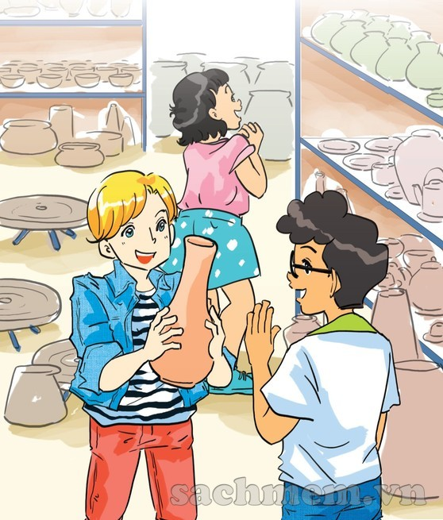
1. Who and what can you see in the picture?
2. Where are they?
3. What do you think the people in the picture are talking about?

Slide 3
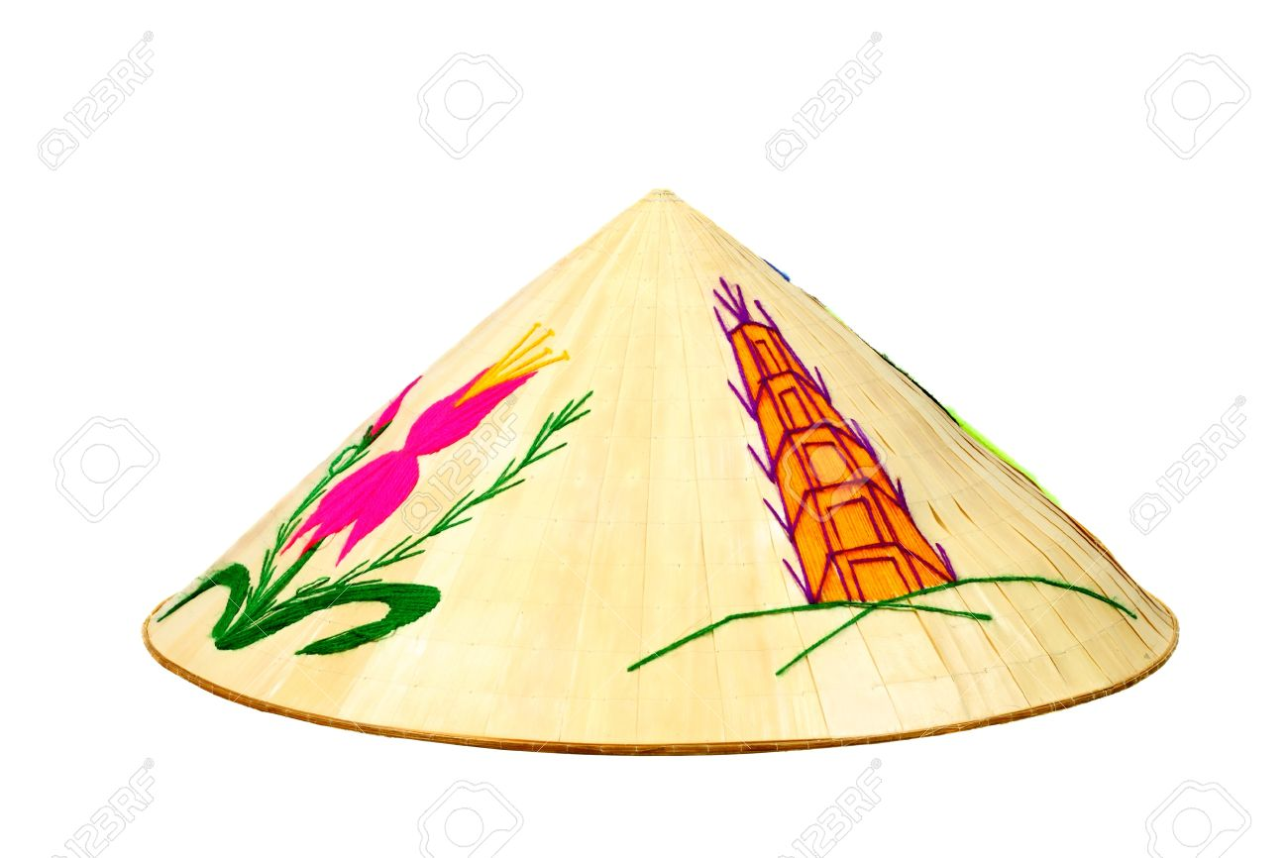
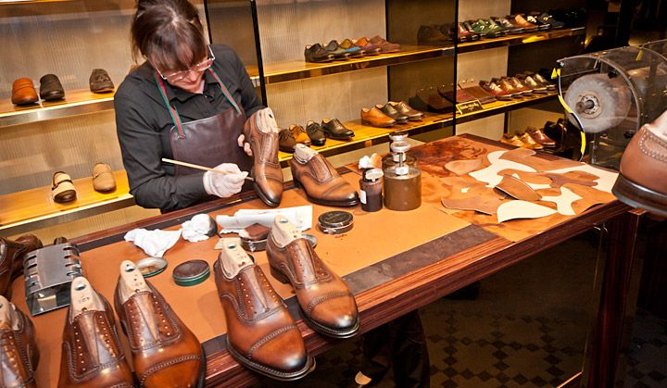
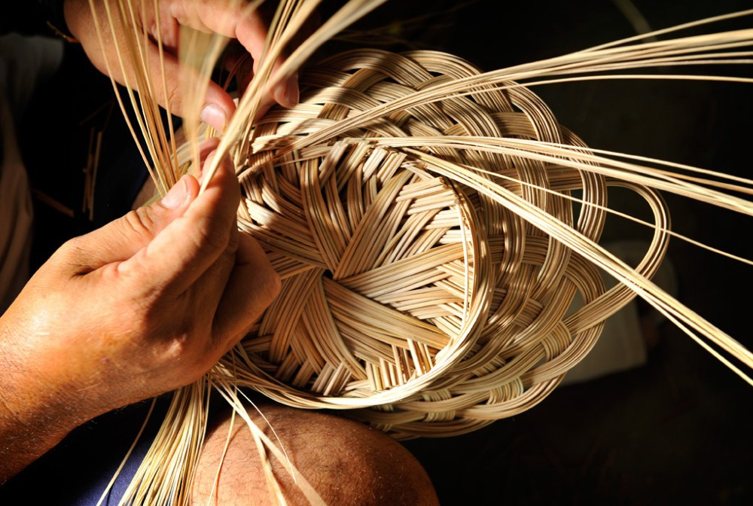
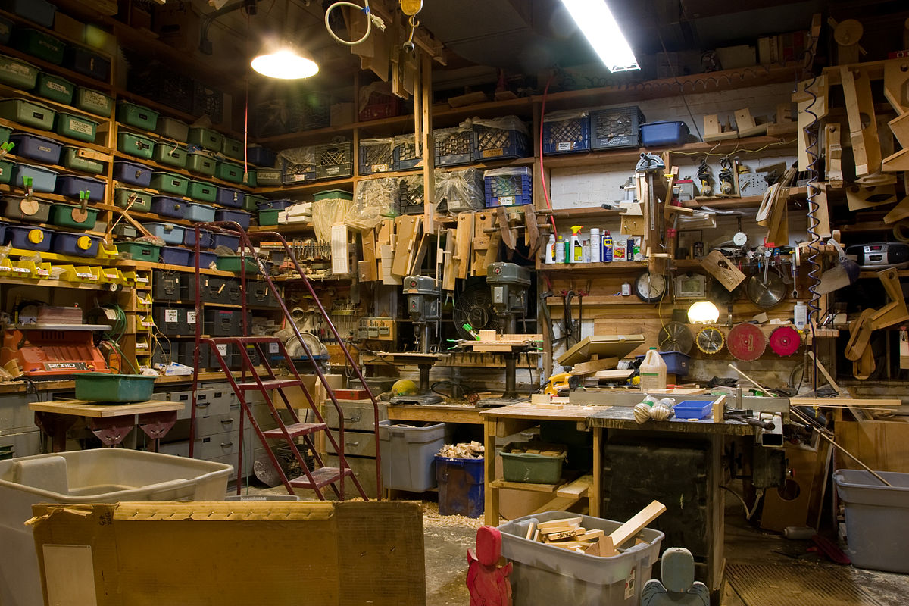
Vocabulary:
artisan /ˌɑːtɪˈzæn/ (n)
thợ thủ công
set up (ph.v)
xây dựng
workshop /ˈwɜːkʃɒp/
xưởng/công xưởng
conical hat /ˈkɒnɪkl hæt/
nón lá
handicrafts/ˈhændikrɑːft/
sản phẩm thủ công
take over (ph.v)
tiếp quản

Slide 4
1. Listen and read:
Nick: There are so many pieces of pottery here, Phong. Do your grandparents make all of them?
Phong: They can’t because we have lots of products. They make some and other people make the rest.
Nick: As far as I know, Bat Trang is one of the most famous traditional craft villages of Ha Noi, right?
Phong: Right. My grandmother says it’s about 700 years old.
Mi: Wow! When did your grandparents set up this workshop?

Slide 5
Phong: My great-grandparents started it, not my grandparents. Then my grandparents took over the business. All the artisans here are my aunts, uncles, and cousins.
Mi: I see. Your village is also a place of interest of Ha Noi, isn’t it?
Phong: Yes. People come here to buy things for their house. Another attraction is they can make pottery themselves in workshops.
Phong: Yes. People come here to buy things for their house. Another attraction is they can make pottery themselves in workshops.

Slide 6
Nick: That must be a memorable experience.
Phong: In Viet Nam there are lots of craft villages like Bat Trang. Have you ever been to any others?
Mi: I’ve been to a conical hat making village in Hue!
Nick: Cool! This is my first one. Do you think that the various crafts remind people of a specific region?
Mi: Sure. It’s the reason tourists often choose handicrafts as souvenirs.
Phong: Let’s go outside and look round the village…

Slide 7
1.a. Can you find a word/phrase that means?
1. a thing which is skillfully made with your hands
2. start something (a business, an organization, etc.)
3. take control of something (a business, an organization, etc.)
4. people who do skilled work, making things with their hands
handicraft
set up
take over
artisans

Slide 8
1.a. Can you find a word/phrase that means?
5. an interesting or enjoyable place to go or thing to do
6. a particular place
7. make someone remember or think about something
8. walk around a place to see what is there
attraction
specific region
remind
look round

Slide 9
1.b. Answer the following questions?
1. Where are Nick, Mi, and Phong?
2. How old is the village?
3. Who started Phong’s family workshop?
4. Why is the village a place of interest in Ha Noi?
5. Where is the craft village that Mi visited?
6. Why do tourists like to buy handicrafts as souvenirs?

Slide 10
1.b. Answer the following questions?
1. Where are Nick, Mi, and Phong?
They are at Phong’s grandparents’ workshop in Bat Trang.
2. How old is the village?
It is about 700 years old.
3. Who started Phong’s family workshop?
His great-grandparents did.
4. Why is the village a place of interest in Ha Noi?
Because people can buy things for their house and make pottery themselves there.
5. Where is the craft village that Mi visited?
It is in Hue.
6. Why do tourists like to buy handicrafts as souvenirs?
Because the handicrafts remind them of a specific region.

Slide 11
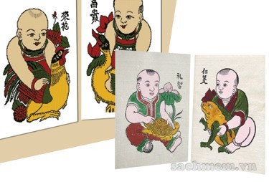
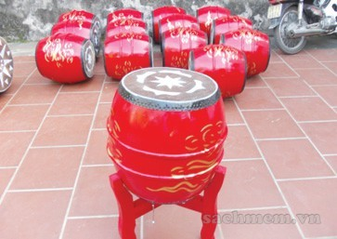
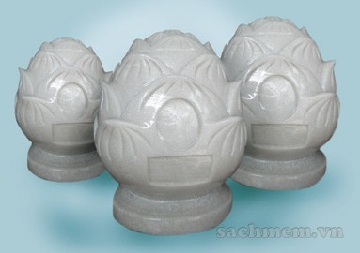
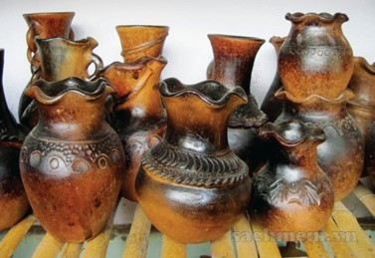
2. Write the name of each traditional handicraft in the box under the picture.
A. paintings
B. drums
C. marble sculptures
D. pottery

Slide 12
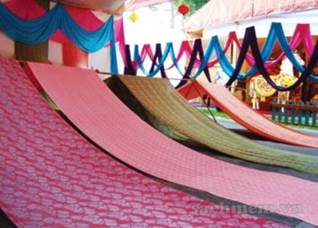
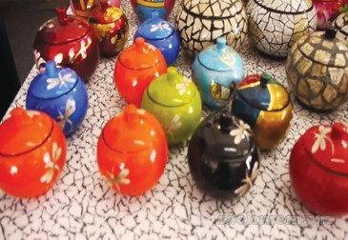
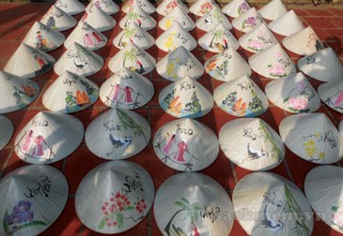
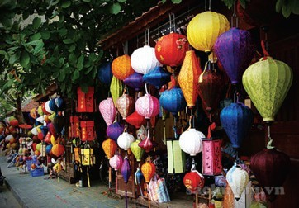
E.silk
F. lacquerware
/ˈlækəweə(r)/
G. conical hats
H. lanterns /ˈlæntən/

Slide 13
3. Complete the sentences with the words/ phrases from 2
conical hat
1. The birthplace of the famous bai tho ……………….
is Tay Ho village in Hue.
2. If you go to Hoi An on the 15th of each lunar month, you can enjoy the lights of many beautiful ……………………….
3. Van Phuc village in Ha Noi produces different types of ……………. products such as cloth, scarves, ties, and dresses.
lanterns
silk

Slide 14
3. Complete the sentences with the words/ phrases from 2
4. On the Tet holiday, many Hanoians go to Dong Ho village to buy folk……………….. .
5. …………… products of Bau Truc, such as pots and vases, have the natural colours typical of Champa culture in Ninh Thuan.
6. Going to Non Nuoc marble village in Da Nang, we’re impressed by a wide variety of …………………………from Buddha statues to bracelets.
paintings
Pottery
marble sculptures

Slide 15
4. Quiz: WHAT IS THE PLACE OF INTERESTS?
a. Work in pairs to do the quiz.
1. People go to this area to walk, play, and relax.
2. It is a place where objects of artistic, cultural, historical, of scientific interest are kept and shown.
3. People go to this place to see animals.
4. It is an area of sand, or small stones, beside the sea or a lake.
5. It is a beautiful and famous place in the countryside.
1.park
2. museum
3. zoo
4. beach
5. beauty spot

Slide 16

- Learn by heart the new words
- Prepare for the next lesson
Homework

