Slide 1
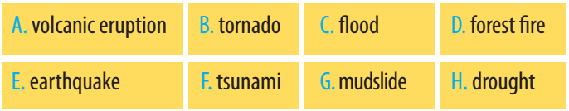
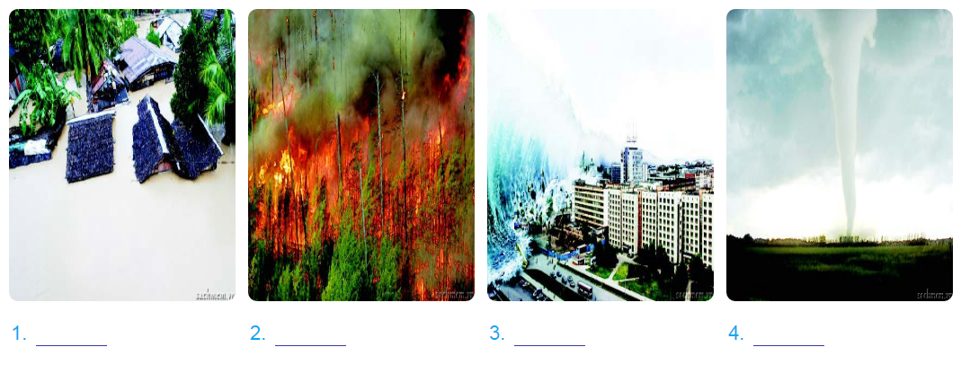





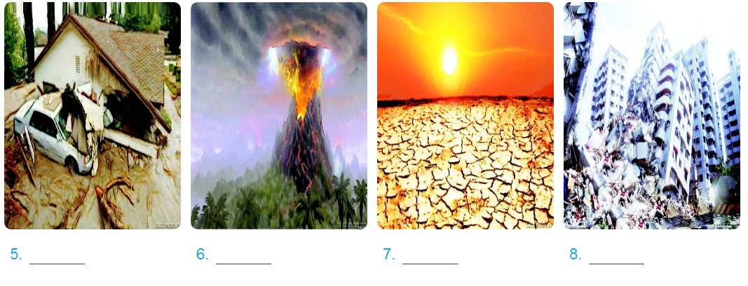




WARM UP:Match the picture with the right natural disaster

Slide 2
GRAMMAR: The passive form( Câu bị động)
S+ BE + Past participle (PP)...
Example:
People speak English all over the world.
S V O
... ......... ......
English
S
is spoken
be + PP
all over the world
by people
O
.......................
Active:
S + V + O .....
Passive:
S+ (BE + PP) ...... By O

Slide 3
1. Complete the sentences using the correct passive form of the verbs in brackets.
A new university (build)……………........in my town in the near future.
Residents of flooded villages (take)………………to a safe place last night.
In the future, natural disasters (predict) …………………. accurately with the help of technology.
Food and medicals supplies (deliver)………………...…..later this afternoon.
will be built
were taken
will be predicted
will be delivered

Slide 4
*Past perfect tense( Thì quá khứ hoàn thành)
Form:
S + had(not) + past participle+ O
+ Most people had moved to safe areas when the storm broke.
- Most people hadn’t moved to safe areas when the storm broke.
? Had Most people moved to safe areas when the storm broke?

Slide 5
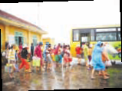
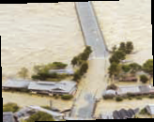
b. When do we use the past perfect? Can you think of any rules?
by 11 o’clock last night
Ex: People had managed to leave the flooded villages by 11 o’clock last night
=>Thì QKHT dùng để miêu tả một hành động xảy ra trước 1 thời điểm xác định trong quá khứ
Ex: People had already left the flooded villages when we arrived.
when we arrived
=>Thì QKHT dùng để miêu tả một hành động xảy ra trước 1 hành động khác trong quá khứ

Slide 6
5.Complete the sentences by putting the verbs in brackets into the simple past or past perfect
Most people (leave)………. before the volcano (erupt)………..
By the time we (arrive)…………. at the USA, it (stop)……….............snowing.
They (spend)…………… the night in the flooded are before help (arrive)……….
Simon (get)……….lost because he (not take) …………. a map with him.
I (find)…………..my pen after I (buy)…………... a new one.
had left
erupted
arrived
had stopped
had spent
arrived
got
hadn’t taken
found
had bought

Slide 7
Changes in Reported Speech
(Những thay đổi trong câu nói gián tiếp)
Person: (Ngôi) It depends
I → he / she my → his / her
we → they you → I/he/she
2. Tenses( Thì) (lùi 1 thì)
Present Simple → Past Simple
Present continuous → Past Continuous
Present Perfect → Past Perfect
Past Simple → Past Perfect
Will → Would May → might
Must / have to → had to
Can → Could
*Could, might, ought to, should, would (giữ nguyên)

Slide 8
Changes in Reported Speech
3. Time(Thời gian)
now → then, at that time
today → that day
yesterday → the day before, the previous day
last week → the week before/ the previous week
last month → the month before / the previous month tomorrow → the following day / the next day
next week → the next week/ the following week
this week → that week
an hour ago → an hour before
here → there

Slide 9
Grammar
4.Change the sentences into reported speech.
1.“People will soon communicate using telepathy.”
He said that…………………………… .
2.“I like learning English with him .”
She said that…………………………… .
3.“They are doing an experiment”
He said……………………………….. .
4.“We have never been to the USA before.”
They announced that……………………………………… .
5.“You have to keep quiet if you want to stay here.”
She told me that ………………………………….
pepole would soon communicate using telepathy.
she liked learning English with you.
they were doing an experiment
they had never been to the USA before.
I had to keep quiet if I wanted to stay there

Slide 10
Grammar
6.“I don’t like to play the piano.”
She said that…………………………… .
7.“I will hand in my assignment to the teacher tommorrow.”
He said that…………………………… .
8.“They have to sign this contact again next week”
She told me……………………………….. .
9. “The meeting can begin at seven o’clock tonight.”
They announced that............................................................
10. “ How can the people on Venus communicated?”
Tom asked..................................................................................
she didn’t like to play the piano.
he would hand in his assingment to the teacher
the next day.( the following day )
they had to sign the contact again the next week
(the following week)
the meeting could begin at seven
o’clock that night
how could people on Venus communicate.

Slide 11
CONDITIONAL SENTENCES TYPE 1 (Điều kiện loại 1)
-Câu ĐK loại 1diễn tả 1 giả thiết có thật ở thời hiện tại hoặc tương lai.
If + S + V ( simple present), S + will / can / may + inf.
If clause main clause
Example: If it rains, you can stay at home.
I will buy a book if I have enough money

Slide 12
GRAMMAR
1. Put the verbs in brackets into the correct form.
recycle
If we (cycle)…………………….. more, we (help) …………………….. the Earth.
2. Factories (not dump) …………………….. waste into rivers if the government (fine)……………... ..them heavily.
3. If people (travel) ………………….. to work by bus, there (be) ……………………. fewer car fumes.
4. We (save) ……………….…. thousands of trees if we
(not waste) ………………………… paper.
5. If we (use)…………………… water carefully, more people (have) ……………………. fresh water.
will help
will not/won’t dump
fines
travel
will be
will save
don’t waste
use
will have

Slide 13
CONDITIONAL SENTENCES TYPE 2 (Điềukiện loại 2)
Câu ĐK loại 2 diễn tả 1 giả thiết không có thật ở thời hiện tại hoặc tương lai.
If + S + V (past simple), S + would / could / might + inf.
If clause main clause
Example: If it wasn’t noisy here, I could hear you clearly. (But it’s very noisy in here)
What would you do if you were the president
- Câu ĐK loại 2 được dùng như là lời khuyên.
Example:If I were you, I would see the doctor immediately.
Note: Chúng ta có thể dùng was hoặc were với chủ ngữ là I / He / She / It ở mệnh đề IF.

Slide 14
3. Match an If clause in A with a suitable main clause in B.
A | B
1. If I were you, | a. What would happen?
2. If Lan wasn’t ill, | b. I’d look for a new place to live.
3. If there were fewer cars on the roads, | c. She would join our tree planting activity.
4. If people really cared about the environment, | d. There would be less pollution.
5. If there was no fresh water in the world, they wouldn’t dump waste into the lake. | e. They wouldn’t dump waste into the lake.

