Slide 1
ENGLISH 8

Slide 2
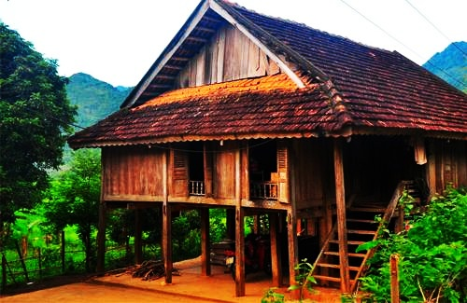
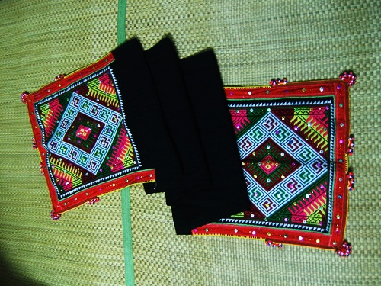
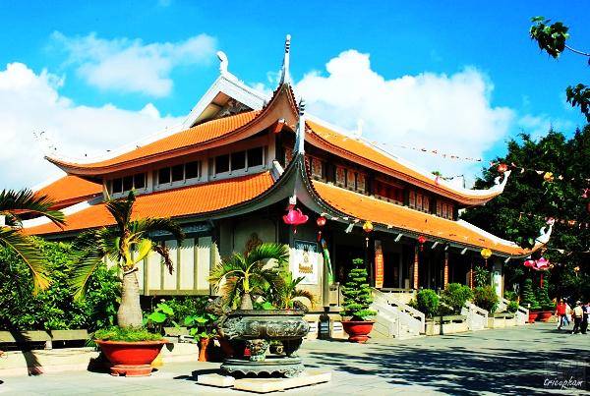
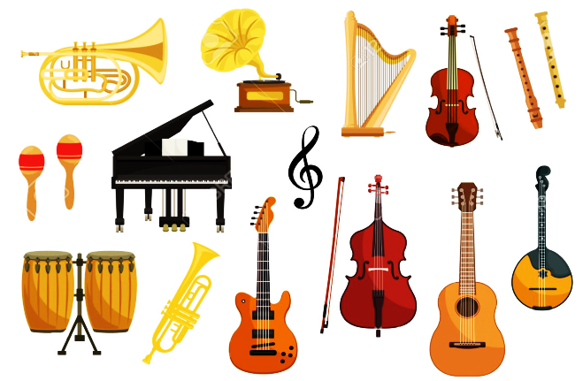
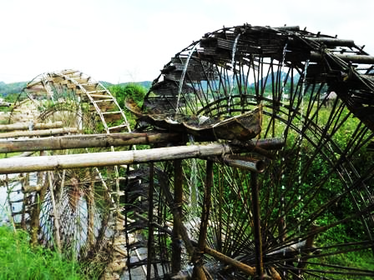
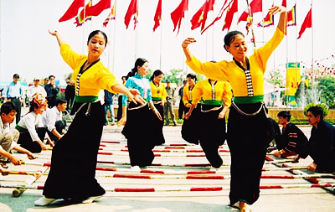
WARM-UP:
Name the pictures
pagoda
waterwheel
stilt house
musical instrument
folk dance
shawl

Slide 3
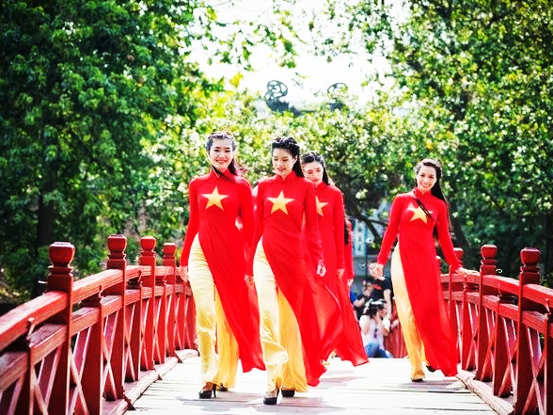
Wednesday, October 28, 2020
New lessons
UNIT 3
LESSON 3: A CLOSER LOOK 2

Slide 4
GRAMMAR
Questions: review

Slide 5
There are seven Wh-questions and one H-question in English:
what
How
which
Question Words
why
where
whose
when
who

Slide 6
who
which
what
where
why
whose
when
how
asking for information about something
asking about choice
asking about ownership
asking about time
asking about person
asking about reason
asking about manner
asking about place

Slide 7
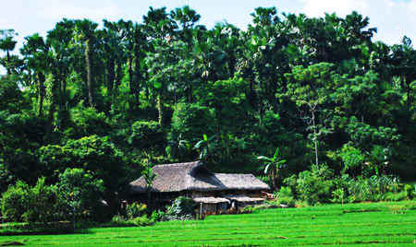
1. Read the passage.
Wednesday, October 28, 2020
The stilt house of the Tay

Slide 8
In a small village in the north, there is a stilt house. In the house, a Tay family are living together: the grandparents called Dinh and Pu, the parents called Lai and Pha, and three children called Vang, Pao and Phong. Every day the grandparents stay at home to look after the house. Mr Lai and Mrs Pha work in the fields. They grow rice and other plants.
Mrs Pha goes to the market twice a week to buy food for the family. Mr Lai sometimes goes hunting or cutting wood in the forests. Pao and Phong go to the primary school in the village, but Vang studies at the boarding school in the town about 15 kilometres away. He goes home at the weekend.
The family live simply and they enjoy their way of life. There are a few difficulties of course. But they say they live more happily in their stilt house than in a modern ﬂat in the city.

Slide 9
2. Now write questions for these answers.
Example:
Answer:
Question:
→ In the north.
→ Where is the small village?

Slide 10
1. A Tay family.
→ _________________________________________?
2. Three children.
→ _________________________________________?
3. Yes, they stay at home to look after the house.
→ _________________________________________?
4. Twice a week.
→ _________________________________________?
5. It is about 15 kilometres.
→ _________________________________________?
6. At the weekend.
→ _________________________________________?
7. They live happily.
→ _________________________________________?
8. No. They like living in their stilt house.
→ _________________________________________?

Slide 11
LUCKY NUMBER
1
9
2
Đội A
8
Đội B
3
20
50
60
40
30
10
70
00
20
30
40
00
10
50
60
70
7
4
6
5
NEXT

Slide 12
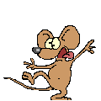
Lucky Number
Lucky Number
You get 10 marks
BACK

Slide 13
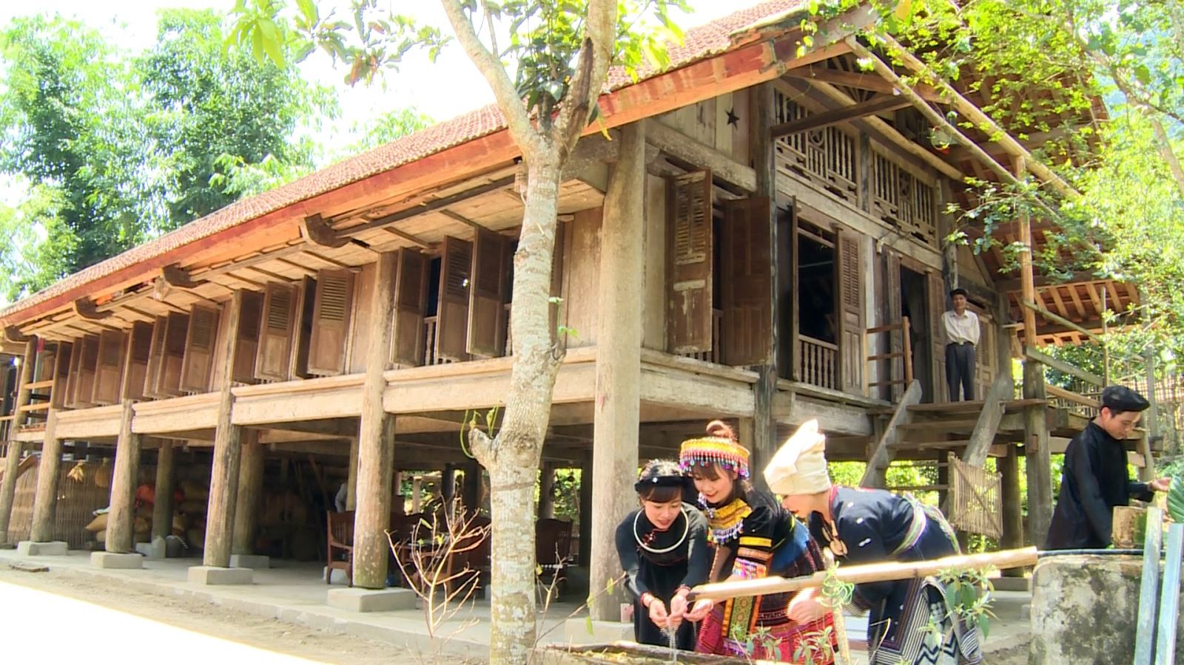
Who is living in the house?
Answer:
1. A Tay family.
BACK

Slide 14
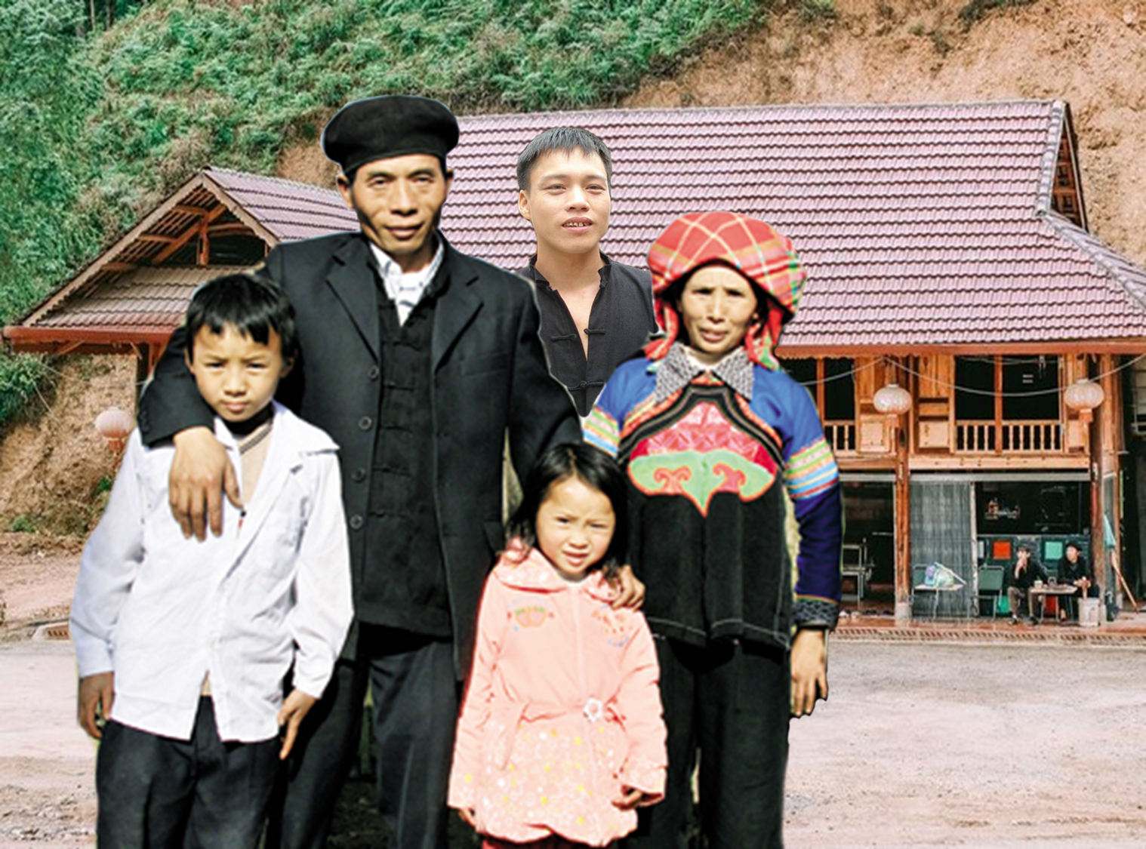
How many children do they have?
Answer:
2. Three children.
BACK

Slide 15
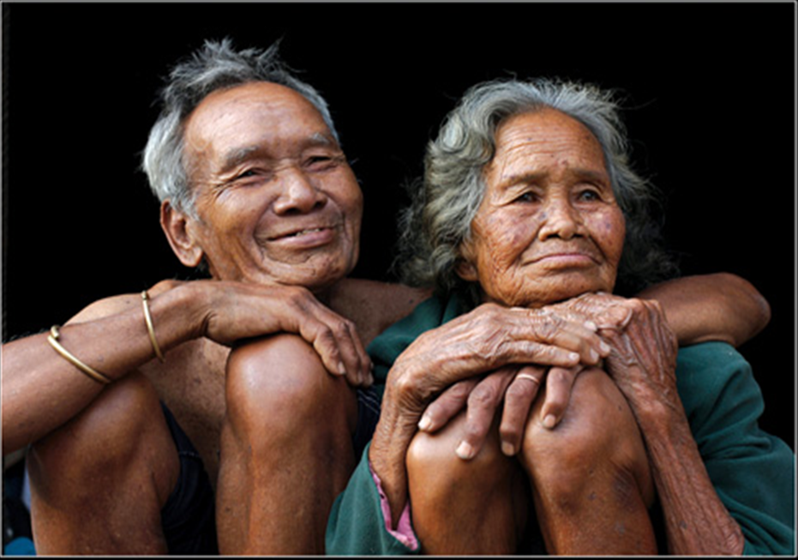
Do the grandparents stay at home?
Answer:
3. Yes, they stay at home to look after the house.
BACK

Slide 16
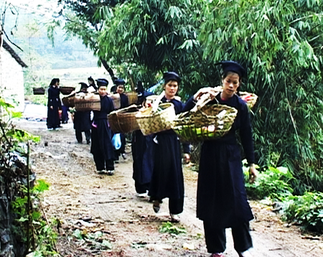
How often does Mrs Pha go shopping?
Answer:
4. Twice a week.
BACK

Slide 17
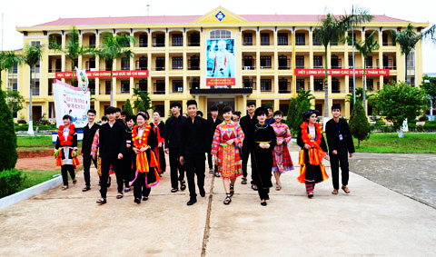
How far is Vang’s boarding school?
Answer:
5. It is about 15 kilometres.
BACK

Slide 18
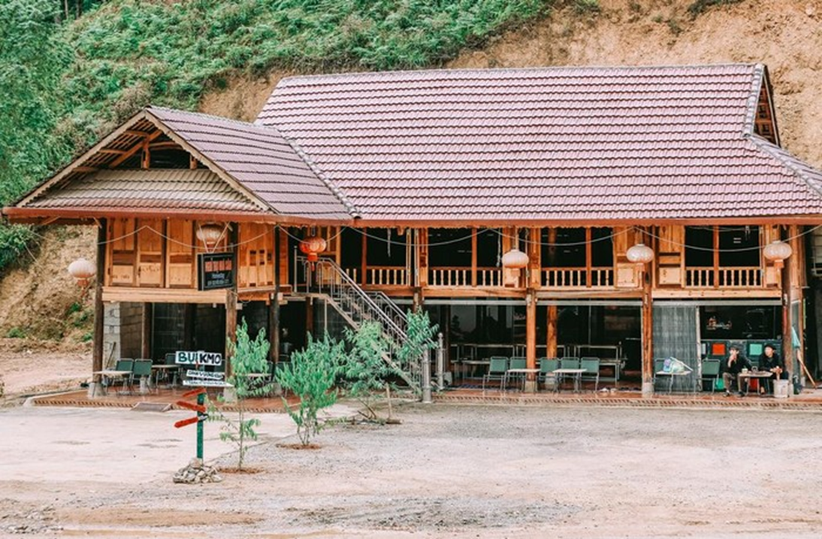
When does Vang go home?
Answer:
6. At the weekend.
BACK

Slide 19
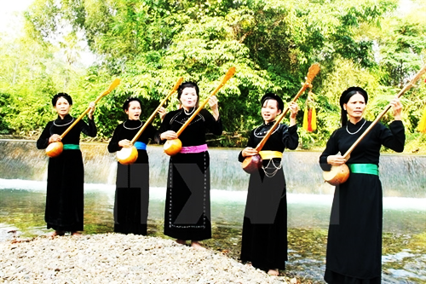
How do they live?
Answer:
7. They live happily.
BACK

Slide 20
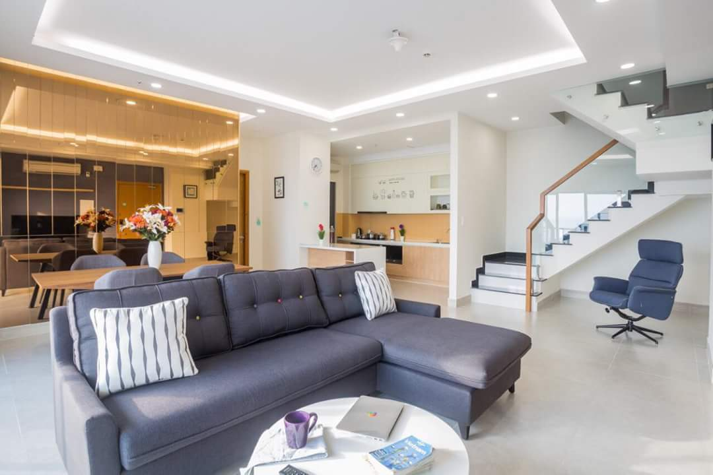
Would they like to live in a modern ﬂat in the city?
Answer:
8. No. They like living in their stilt house.
BACK

Slide 21
1. A Tay family.
→ _________________________________________?
2. Three children.
→ _________________________________________?
3. Yes, they stay at home to look after the house.
→ _________________________________________?
4. Twice a week.
→ _________________________________________?
5. It is about 15 kilometres.
→ _________________________________________?
6. At the weekend.
→ _________________________________________?
7. They live happily.
→ _________________________________________?
8. No. They like living in their stilt house.
→ _________________________________________?
Who is living in the house
How many children do they have
Do the grandparents stay at home
How often does Mrs Pha go shopping
How far is Vang’s boarding school
When does Vang go home
How do they live
Would they like to live in a modern ﬂat in the city

Slide 22
2. Now write questions for these answers.
Questions | Answers
 | 1. A Tay family.
 | 2. Three children.
 | 3. Yes, they stay at home to look after the house.
 | 4. Twice a week.
 | 5. It is about 15 kilometres.
 | 6. At the weekend.
 | 7. They live happily.
 | 8. No. They like living in their stilt house.
Who is living in the house?
How many children do they have?
Do the grandparents stay at home?
How far is the town?
When does Vang go home?
How do they live?
Would they like to live in a modern ﬂat in the city?

Slide 24
3. Complete the questions using the right question words.
1. A: _______ is the class monitor?
B: Dan is.
2. A: _______ is the biggest house in this village?
B: The communal house (nha rong) is.
3. A: _______ do you think is the most interesting museum in Ha Noi?
B: The Museum of Ethnology.
4. A: _______ is more colourful, the Nung’s or the Hoa’s costume?
B: The Hoa’s, of course.
5. A: _______ is the waterwheel used for?
B: It is used to get water to the fields.
Who
Which
Which
Which
What

Slide 25
4. Work in pairs. Make questions and answer them.
1. Who/ do/ shopping/ your family?
___________________________________
2. Who/ principal/ our school?
___________________________________
3. Which subject/ like better/ English/ Maths?
___________________________________
4. What/ most important festival/ Viet Nam?
___________________________________
5. Which ethnic group/ larger population/ Khmer/ Cham?
___________________________________
Who does the shopping in your family?
Who is the principal of our school?
Which subject do you like better, English or maths?
What is the most important festival in Viet Nam?
The Lunar New Year
The Khmer: 1,260,600 (The Cham: 161,700)
Which ethnic group has a larger population, the Khmer or the Cham?

Slide 26
GRAMMAR
Articles: a, an, and the

Slide 27
a: - used before a countable singular noun:
Pao needs a costume for the festival.
- used to mean ‘any, every’:
A lion lives in the jungle.
an: used instead of a before a noun beginning with a vowel sound:
There is an exhibition of Cham arts in the city.
the: - used before a noun that has already been mentioned or is easily understood:
There’s a festival in my village. The festival is very old.
- used to refer to a noun that is the only, or obvious one of their kind:
The Kinh speak Vietnamese.
- used before superlative comparison of adjectives and adverbs:
The Odu have the smallest number of people.
Notes

Slide 28
5. Underline the correct article to finish the sentences.
1. Viet Nam is (a / an / the) multicultural country with 54 ethnic groups.
2. Among the ethnic minorities, (a / an / the) Tay have the largest population.
3. (A / An / The) ethnic minority people in the village are very friendly.
4. The Lao are one of (a / an / the) many Thai-speaking peoples.
5. The Lolo women’s dress is among (a / an / the) most striking styles of clothing worn by ethnic peoples.
6. The Yao have (a / an / the) rich culture of folk literature and art, with tales, songs, and poems.

Slide 29
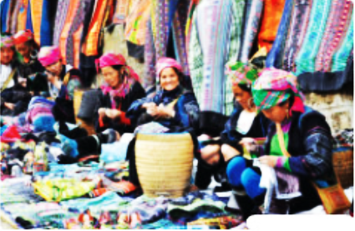
6. Insert a, an or the in each gap to finish the passage.
When you travel to a north-west mountainous region and you want to have (1) _____ great time, you can go to (2) _____ local open-air market. (3) ____ sight there is beautiful.
Local people in colourful clothing are smiling as they sell or buy their local products. The goods there are diverse. You can buy all kinds of fruit and vegetables, which are fresh and cheap. You can also buy a nice costume of (4) ______ ethnic group you like. If you don’t want to buy anything, just go round and enjoy looking. You can also taste some specialities of (5) _____ local people sold right there at the market. I am sure you will have (6) _____ unforgettable time.
a
a
the
an/the
the
an

Slide 30
CONSOLIDATION: a) Write questions for the underlined parts in the following sentences.
1. It has been the National Day of Vietnam since 1945.
____________________________________________?
2. Hung Kings are the founders of our nation and they became the first kings of our country.
____________________________________________?
3. Most ethnic peoples in Vietnam speak their own languages.
____________________________________________?
5. The items on display in the Vietnam Museum of Ethnology are very interesting.
____________________________________________ ____________________________________________?
How long has it been the Natinal Day of Vietnam
Who are the founders of our nation
What languages do most ethnic peoples in VN speak
How are the items on display in the Vietnam Museum of Ethnology

Slide 31
CONSOLIDATION: b) Fill in the blanks with a suitable article (a, an, the) or no article (Ø).
the
1. Are you coming to ____ party next Saturday?
2. I bought ____ new TV set yesterday.
3. I think ____ man over there is very ill. He can't stand on his feet.
4. I watched ____ video you had sent me.
5. She was wearing ____ ugly dress when she met him.
6. I am crazy about reading ____ history books.
7. She is ____ nice girl.
8. Do you want to go to ____ restaurant where we first met?
9. He is ____ engineer.
10.He thinks that ____ love is what will save us all.
a
the
the
an
Ø
a
the
an
Ø

Slide 32
HOMEWORK
- Review the grammar points: WH-words and articles (a, an, the).
- Do exercises B 1, 2, 3, 4, in workbook (page 24 and 25)
- Prepare for Unit 3: Communication
+

Slide 33
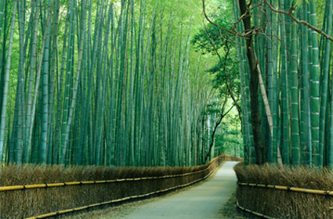
THANKS FOR YOUR ATTENTION!
Goodbye!
See you again!

