Slide 1
WELCOME TO MY CLASS
Good morning Everybody

Slide 2
Date
UNIT ONE
LEISURE ACTIVITIES
Lesson 1
GETTING STARTED
IT’S RIGHT UP MY STREET!

Slide 3
Free time
* WARM UP
Teacher: Tran Thi Hanh

Slide 4
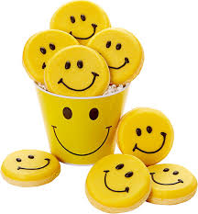
Leisure Activities
Things you do in your free time

Slide 5
What do you like doing in your free time?
I like playing computer games.

Slide 6
Leisure Activities
Indoor Activities | Outdoor Activities
Things you do inside | Things you do outside

Slide 7
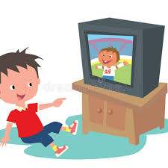
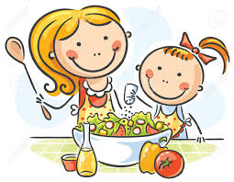
Indoor Activities

Slide 8
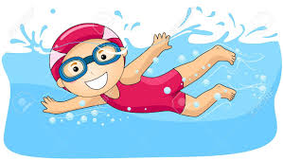
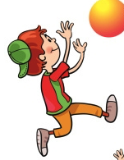
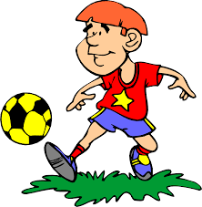
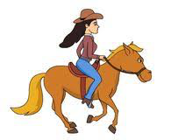
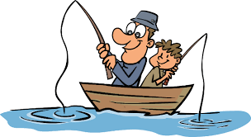
Outdoor Activities

Slide 9
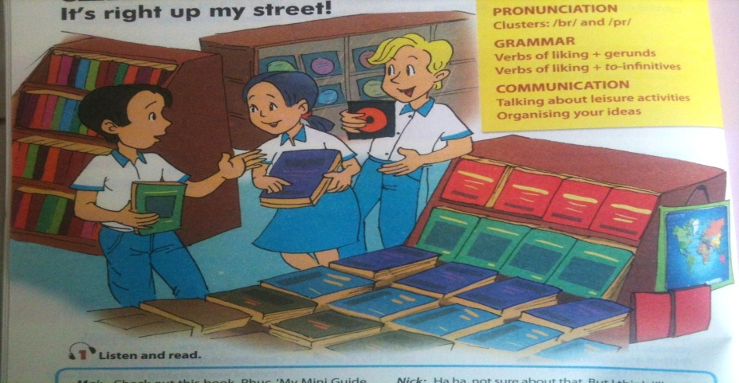
1. WHERE ARE MAI, PHUC AND NICK?
2. What are they holding in their hands?
3. What do they like doing in their free time?

Slide 10
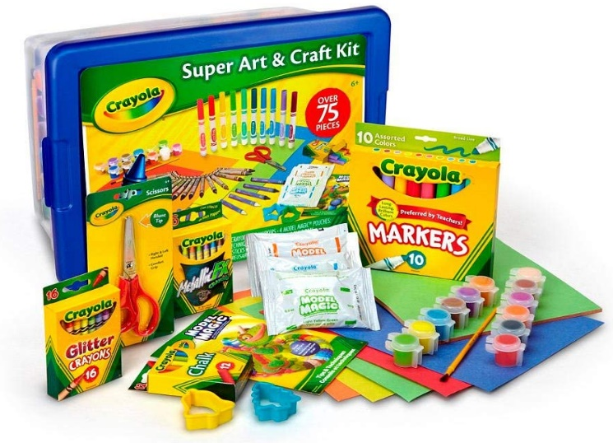
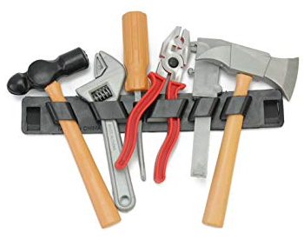
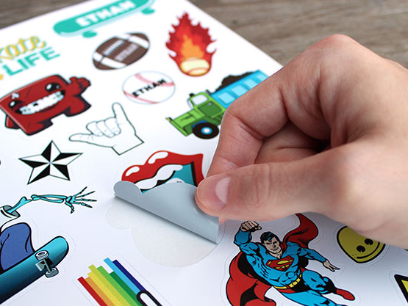
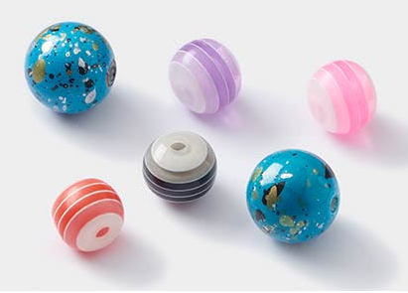
Vocabulary:
- check out /tʃek aʊt/ (v)
guide /gaɪd / (n)
trick /trɪk/ (n)
craft kit /krɑːft kɪt / (n)
bead /biːd / (n)
sticker /ˈstɪkə(r) /(n)
- improve /ɪmˈpruːv / (v)
tool /tuːl/ (n)
- kiểm tra, xem
- hướng dẫn
- mẹo, trò lừa
- bộ đồ thủ công
- hạt, hột (tròn)
- giấy dán, hình dán
cải thiện
công cụ, dụng cụ
- it’s right up my street !(exp)
Hợp ý mình mà.

Slide 11
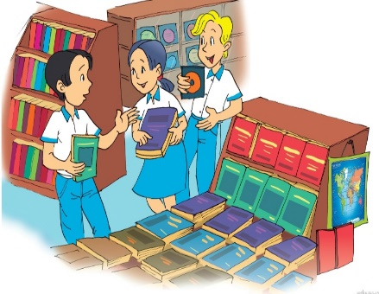
1. Listen and read
It's right up my street!
Mai: Check out this book, Phuc. 'My Mini Guide to Dog Training'.
Phuc: Sounds great! Max'll like it too. Last weekend we learnt some tricks. I love to watch him. It's so much fun... Have you found your craft kit?
Mai: Yes, I've found this one. It's got everything: beads, stickers, wool, buttons... I don't know, it'll take all my savings.
Phuc: But it's right up your street! Nick, what's that?
Nick: It's a CD of Vietnamese folk songs. I'll listen to it tonight.
Mai: And you'll be able to improve your Vietnamese!
Nick: Ha ha, not sure about that. But I think I'll enjoy listening to the melodies.
Phuc: Look at the language website I sent you. It'll help you learn Vietnamese more easily.
Nick: Yes, I liked reading Doraemon comics while was learning Japanese.
Phuc: Stop reading comics! I'll bring you my favourite short story this Sunday when we play football.
Mai: Sorry but we have to hurry. Mum and dad are waiting. We need to buy some tools to build a new house for Max this weekend.

Slide 12
EX. a
/ P. 7
a. Circle the correct answer.
1. Phuc, Mai and Nick are in a ________.
A
library
WHAT A PITY !
B
bookstore
PERFECT
SORRY !
C
sports club

Slide 13
EX. a
/ P. 7
2. Phuc is looking for a ___________.
A
book
PERFECT
B
dog
WHAT A PITY !
C
craft kit
SORRY !

Slide 14
EX. a
/ P. 7
3. Max is Phuc’s _______.
dog
A
PERFECT
cat
B
SORRY !
C
goldfish
WHAT A PITY !

Slide 15
EX. a
/ P. 7
4. Mai has found a _________ for herself.
A
book
WHAT A PITY !
B
CD
SORRY !
C
craft kit
PERFECT

Slide 16
EX. a
/ P. 7
5. Nick’s CD is of ____.
A
folk music
PERFECT
B
pop music
SORRY !
C
rock music
WHAT A PITY !

Slide 17
EX. a
/ P. 7
6. Nick is trying to learn ______.
A
Japanese
SORRY !
B
Vietnamese
PERFECT
C
English
WHAT A PITY !

Slide 18
2. Tick the boxes. Then find the information from the conversation to explain your choice. (Ex. b/ p. 7)
 | PHUC | MAI | NICK
Pet training
Making crafts
Reading
Listening to music
Learning languages
Playing sports
Helping parents with DIY projects

Slide 19
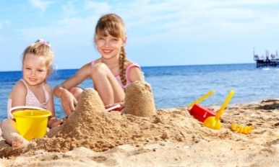
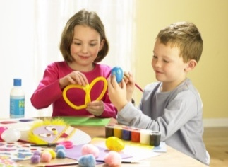
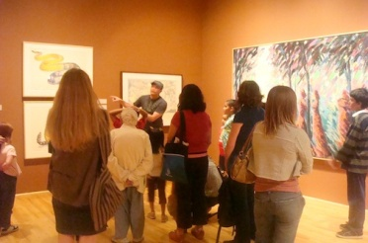
III. PRACTICE
2. Find words or phrases in the box to describe the photos. Then listen to check the answers. (Ex. 2/ p. 7)
Playing beach games
Playing football
Making crafts
Texting
Playing computer games
Visiting museums
Doing DIY
1
2
3
4
5
6

Slide 20
3.Complete the following sentences with words in the box.
(Ex. 3/ p. 7)
good relaxing fun
satisfied exciting boring
1. You do leisure activities in your free time and they make you feel_________________.
2. You can do ___________ activities such as yoga or ___________ ones such as mountain biking or skateboarding.
3. Hobbies such as making crafts or collecting things are _________.
4. You can surf the internet but some people say this is ___________.
5. You can spend time with family and friends, or become a volunteer for the community. This will make you feel _________________.
good / satisfied
relaxing
exciting
fun
boring
good / satisfied

Slide 21
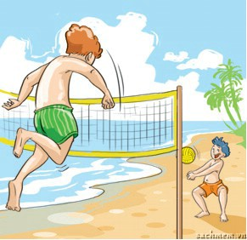
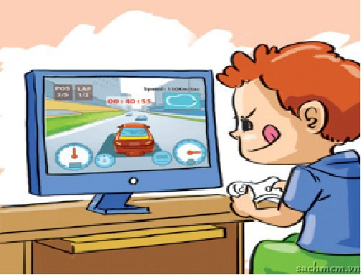
4. Game : Name leisure activities
Playing computer games
Playing beach games

Slide 22
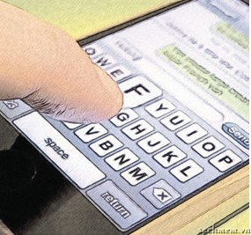
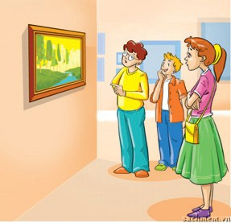
Texting
Visiting museums

Slide 23
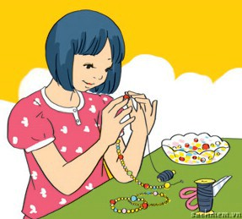
Doing DIY
Making crafts

Slide 24
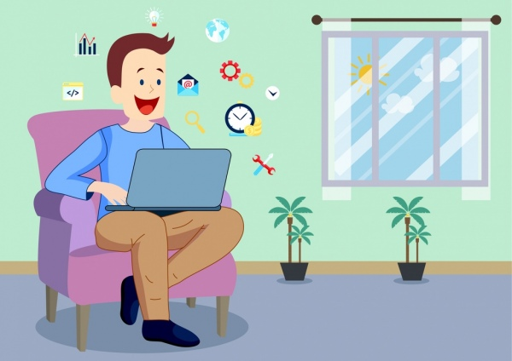
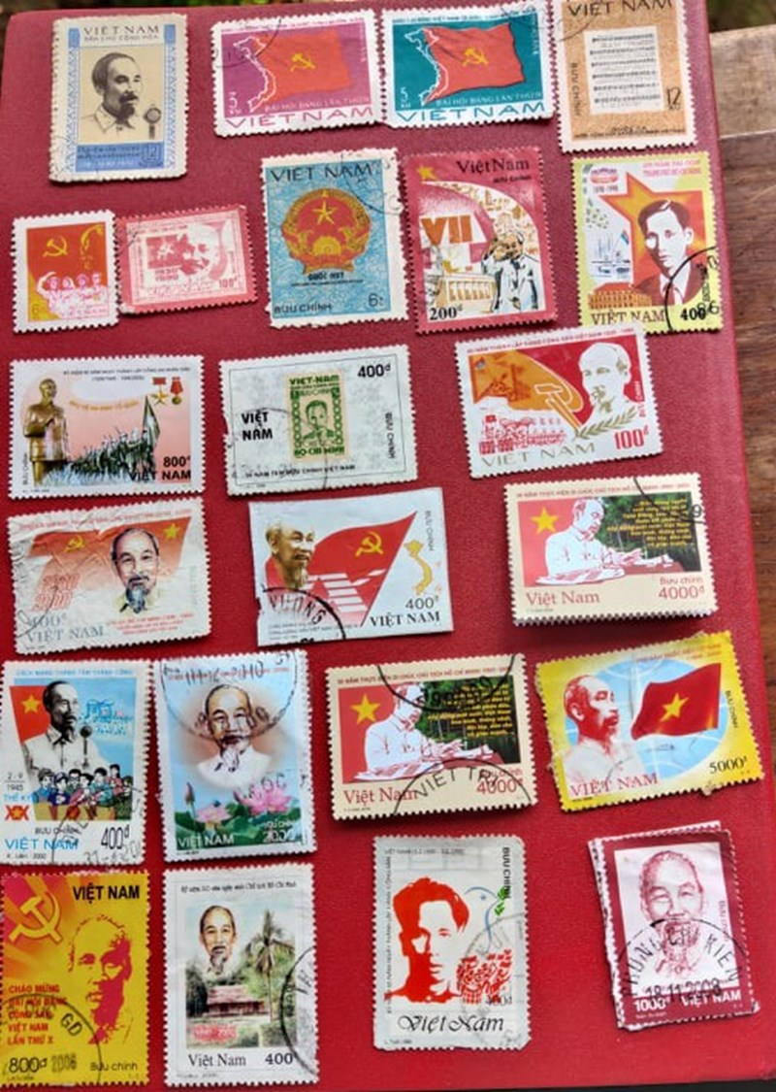
Collecting stamps
Surf the Internet

Slide 25
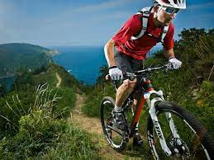
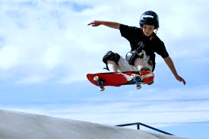
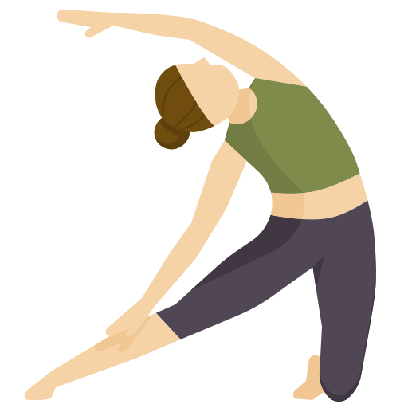
Yoga
Mountain biking
Skateboarding

Slide 26
5. Write about your leisure activity
Model Writing
Playing computer games is one of my leisure activities. It’s so exciting to play many kinds of games on computer. I like Mario, Plants vs zombies,... they are very interesting. I feel so excited to play them.

Slide 27
IV. AT HOME
Learn by heart new words.
Practice dialogue with your friends.
Read the “learning trip” and do the ex. C / p. 7.
Be ready for A CLOSER LOOK 1.

Slide 28
The bye bye song
Bye, bye.
See you tomorrow.
Bye, bye.
See you tomorrow.
Bye, bye.
See you tomorrow.
Bye, bye. Bye, bye.
The bye bye
song
Notes:
28

Slide 29
I. New words:

